Slide 1
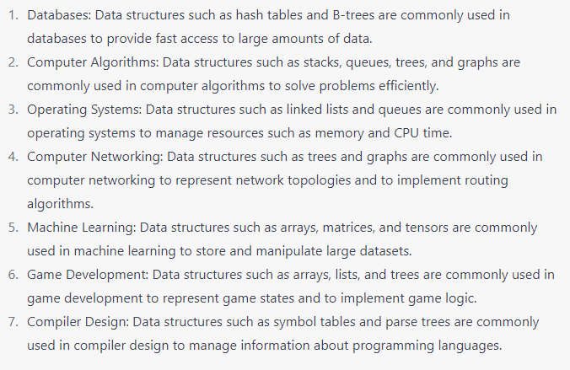
Data Structure
A data structure is a specialized format for organizing, processing, retrieving and storing data. In other words, Data structure is the systematic way to organize data so that it can be used efficiently.
Real Life Application of Data Structure:

Slide 2
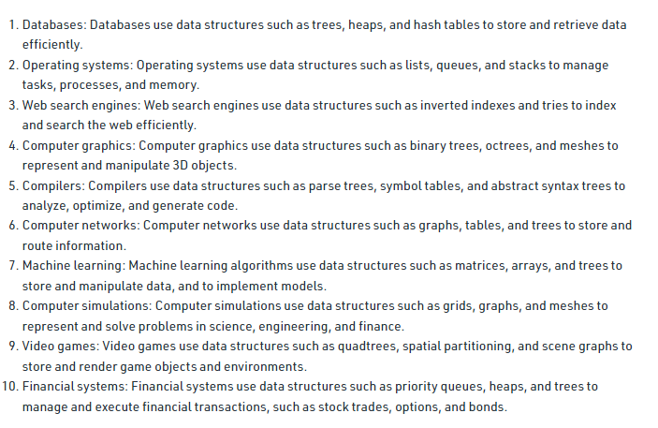
More Applications of Data Structure

Slide 3
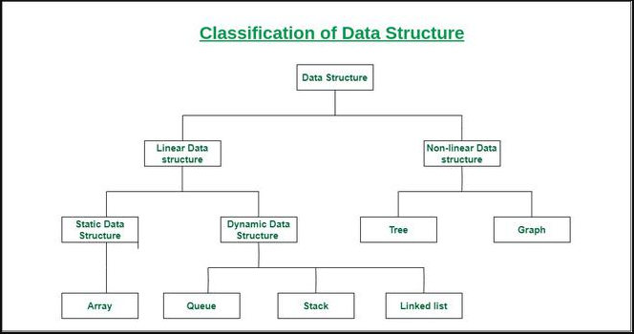
Types of Data Structure

Slide 4
Linear Data Structure
Data elements are arranged sequentially or linearly, where each element is attached to its previous and next adjacent elements.
Example of Linear Data Structures: are array, stack, queue, linked list, etc.
Linear Data Structure is also two types: Static and Dynamic
Static: Static data structure has a fixed memory size. It is easier to access the elements in a static data structure, but slower insertion and deletion operation. Memory is allocated during compile time.
Examples: Array
Dynamic:
The memory size is not fixed. Memory is allocated during run time. That’s why memory size is flexible. Faster insertion and deletion but slower access.
Can be randomly updated during the runtime.
Considered efficient concerning the memory (space) complexity of the code.
Examples: queue, stack, linked list etc.

Slide 5
Non-linear data structure
Data elements are not placed sequentially or linearly.
Can’t traverse all the elements in a single run only.
It could be cyclic and has multiple successors
Examples: Tree and Graph

Slide 6
Why Data Structure
Data structures provide an easy way of organizing, retrieving, managing, and storing data.
Data structure modification is easy.
It requires less time.
Save storage memory space.
Data representation is easy.
Easy access to the large database.

